Slide 1
Lecture 9: Transactions

Slide 2

Roadmap
Database Designer:
Introduction to the Relational Model (Chapter 2)
Database Design and the Relational Mode (Chapters 7 and 8)
Database Programmer:
Introduction to SQL (Chapter 3)
Intermediate SQL (Chapter 4)
Design database applications for Casual Users:
Advanced SQL (Chapter 5)
Human Computer Interaction
Database Administrator:
Transaction Management (Chapter 14)
Concurrency Control (Chapter 15)
Recovery (Chapter 16)
Indexing (Chapter 11)
Database systems developers:
Query Evaluation and Optimization

Slide 3
A Bird’s Eye View of DBMS
Create Tables
DB Application Programmer
DB Casual User
Enter Data
Queries: Find all students who are enrolled in CS101
SQL
SELECT StudentID
FROM Enrollement
Where CourseID = CS101
Java / C++
Course Information
Enter Course ID
DBMS
Student_Id
SName
Data Model
DB Designer
Query Parser
10032
Adam
DB Administrator
Tuning
10554
Joe
StudentID
SName
10345
Lina
Query Optimizer
Handles security and authorization
Data availability, crash recovery
Database tuning as needs evolve
DB Developer
Students
Course_Id
CName
Query Operators
CS101
DB
CS122
Math
Student_Id
Course_ID
Enrollment
Index
10345
CS101
10051
CS101
Courses
Disk
CourseID
CName

Slide 4
Real-world Transactions
Examples:
Buying a product
Registering in a course
Making a deposit in a checking account
One transaction consists of more than one query:
Sales transaction:
Updating (or adding) the customer account
Adjusting the product inventory
Updating the seller’s account
A transaction should be either entirely completed or entirely aborted

Slide 5
Database Transaction
Database request:
Any action that READS from and/or WRITES to the database tables
Each request generates several input/output (I/O) operations
A transaction may consist of:
A series of SELECT/INSERT/UPDATE/DELETE commands/queries
Each query requires several database READ/WRITE operations
A database transaction should be either entirely completed successfully or entirely aborted:
NO intermediate states are accepted
If one SQL statement fails:
The transaction should be rolled back
Collection of operations that form a single logical unit of work
are called transactions

Slide 6
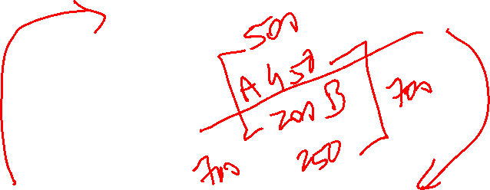
Example of Fund Transfer as database actions
Transfer $50 from account A to account B:
1. read(A)
2. A := A – 50
3. write(A)
4. read(B)
5. B := B + 50
6. write(B)
Two main issues to deal with:
Failures of various kinds, such as hardware failures and system crashes
Concurrent execution of multiple transactions accessing same data

Slide 7

Example of Fund Transfer (continued)
Consistency requirement in above example:
is that the sum of A and B be unchanged by the execution of the transaction
In general, consistency requirements include
Explicitly specified integrity constraints such as primary keys and foreign keys
Implicit integrity constraints
e.g. sum of balances of all accounts, minus sum of loan amounts must equal value of cash-in-hand
A transaction must see a consistent database.
During transaction execution the database may be temporarily inconsistent.
When the transaction completes successfully the database must be consistent
Erroneous transaction logic can lead to inconsistency
Ensuring consistency for individual transaction is the role of application developer

Slide 8

Failure-Related Problem
Transferring money between two accounts:
UPDATE ACCOUNTS
SET BALANCE1 = BALANCE1 – 50
WHERE ACCT_NUM = 8888
UPDATE ACCOUNTS
SET BALANCE2 = BALANCE2 + 50
Where ACCT_NUM = 9999
If the system fails between these two updates, money may be withdrawn but not re-deposited

Slide 9
Example of Fund Transfer (continued)
Atomicity requirement
if the transaction fails after step 3 (write A) and before step 6 (write B), money will be “lost” leading to an inconsistent database state
Failure could be due to software or hardware
the system should ensure that updates of a partially executed transaction are not reflected in the database
Rollback log: database keeps track of old values. In case of failure, this value is restored (More in Recovery chapter)

Slide 10
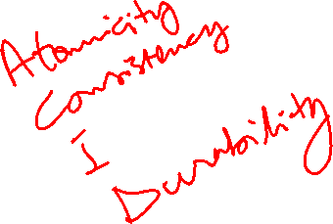
Example of Fund Transfer (continued)
Durability requirement — once the user has been notified that the transaction has completed (i.e., the transfer of the $50 has taken place), the updates to the database by the transaction must persist even if there are software or hardware failures. How?
By ensuring updates have been written to disk
Information about updates is written to disk
Backups taken with restore capability

Slide 11
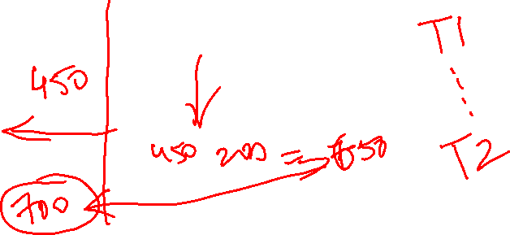
Example of Fund Transfer (continued)
Isolation requirement — if between steps 3 and 6, another transaction T2 is allowed to access the partially updated database, it will see an inconsistent database (the sum A + B will be less than it should be). T1 T2
1. read(A)
2. A := A – 50
3. write(A) read(A), read(B), print(A+B)
4. read(B)
5. B := B + 50
6. write(B)
Isolation can be ensured trivially by running transactions serially
that is, one after the other.
However, executing multiple transactions concurrently has significant benefits

Slide 12
ACID Properties
A transaction is a unit of program execution that accesses and possibly updates various data items.To preserve the integrity of data the database system must ensure:
Atomicity. Either all operations of the transaction are properly reflected in the database or none are.
Consistency. Execution of a transaction in isolation preserves the consistency of the database, from start of transaction to end.
Isolation. Although multiple transactions may execute concurrently, each transaction must be unaware of other concurrently executing transactions. Intermediate transaction results must be hidden from other concurrently executed transactions.
That is, for every pair of transactions T_{i} and T_{j}, it appears to T_{i} that either T_{j}, finished execution before T_{i} started, or T_{j} started execution after T_{i} finished.
Durability. After a transaction completes successfully, the changes it has made to the database persist, even if there are system failures.

Slide 13
Database state
Consistent database state:
All entity and referential integrity constraints are satisfied
To ensure database consistency:
A transaction changes the database from one consistent state to another consistent state

Slide 14
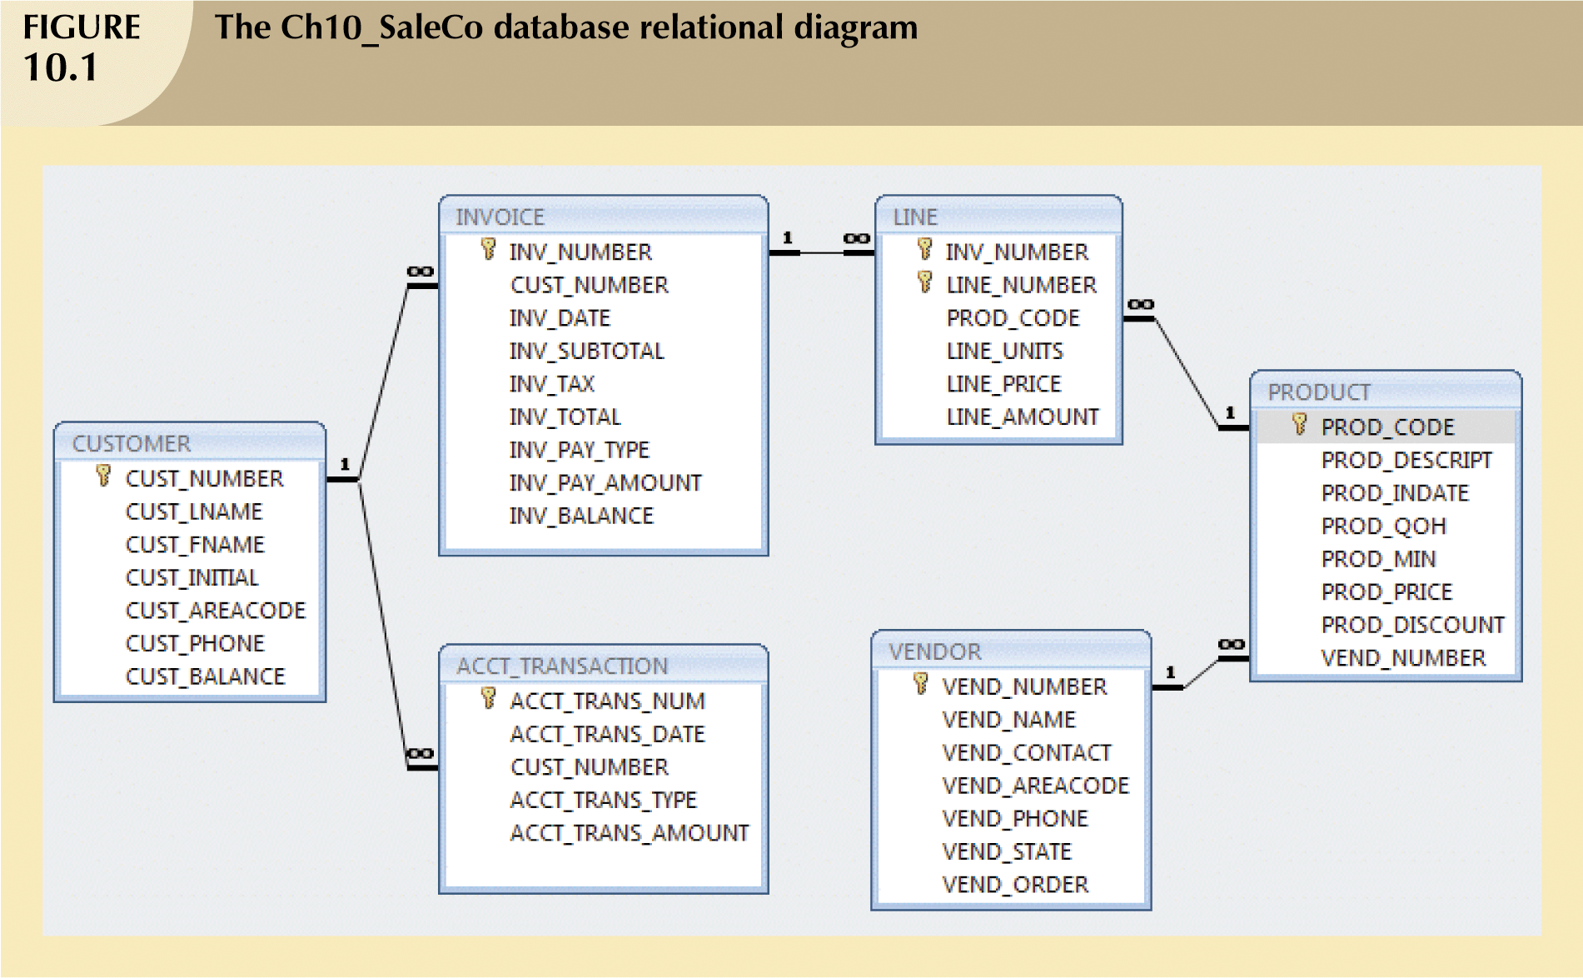


Slide 15

Customer’s Sales Transaction
When a customer makes a purchase:
Write a new customer invoice
Write the corresponding invoice lines
Reduce QOH for the corresponding product
Update CUST_BALANCE
Update ACCT_TRANSACTION

Slide 16
What is the action happening here?
Invoice is created for customer
Items purchased create in Invoice Lines
QOH reduces for the product
CUS_BALANCE increases when a customer makes a purchase
ACCT_TRANSACTION table:
Records all customer purchases and payments

Slide 17
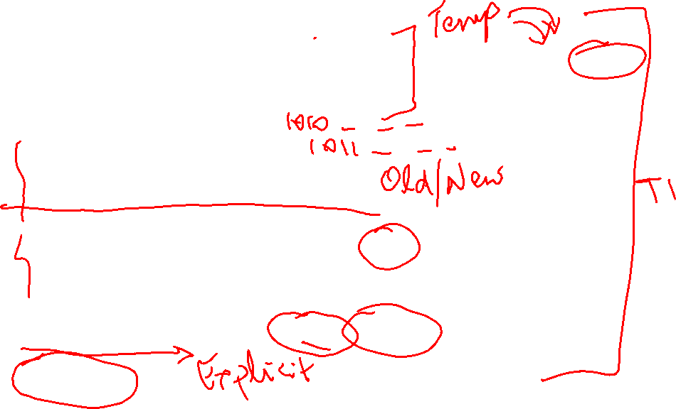
INSERT INTO INVOICE VALUES
(1009,10016,’18-Oct-2019’, 256.99, 20.56,277.55,’cred’,0.00,277.55)
2. INSERT INTO LINE VALUES (1009,1,’89-WRE-Q’,1,256.99,256.99)
3. UPDATE PRODUCT
SET PROD_QOH = PROD_QOH -1
WHERE PROD_CODE = ’89-WRE-Q’
4. UPDATE CUSTOMER
SET CUS_BALANCE = CUS_BALANCE + 277.5
WHERE CUS_CODE = 10016
5. INSERT INTO ACCT_TRANSACTION VALUES
(10007,’18-Jan-2008’,10016,’charge’,277.55)
6. COMMIT;

Slide 18
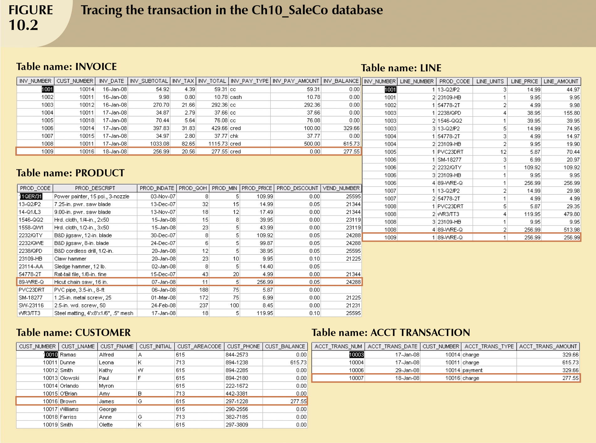


Slide 19
Failure!!
What if a computer failure takes place after step 3?
A new invoice and invoice line is added
The product QOH is updated
Customer is not charged!!
The transaction is not reported in ACCT_TRANSACTION!!
➔ INCONSISTENT Database state

Slide 20

Solution?!!
DBMS Transaction Management:
Module of DBMS to monitor transaction progress and performance
ROLL BACK (when there is a failure)
Cancel the operations of the uncompleted transaction
Return INVOICE, LINE, and PRODUCT tables to their states before the transaction
Roll back the database to a previous consistent state

Slide 21
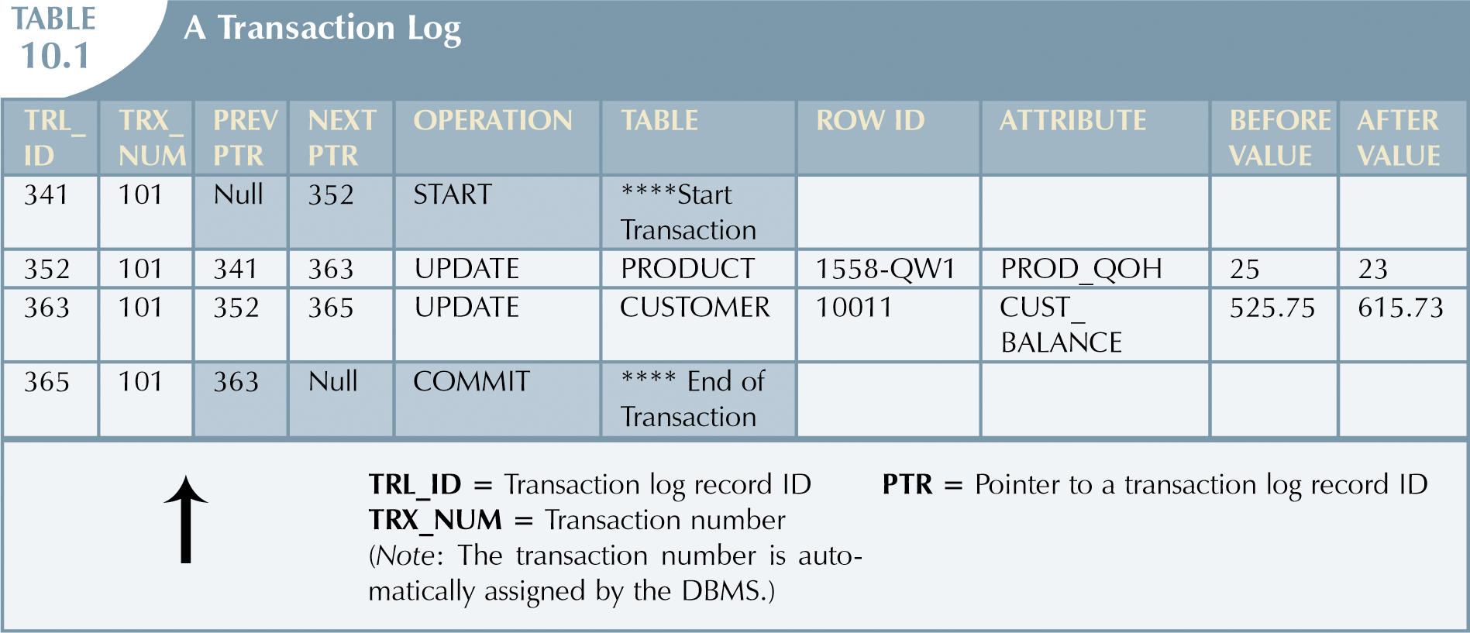
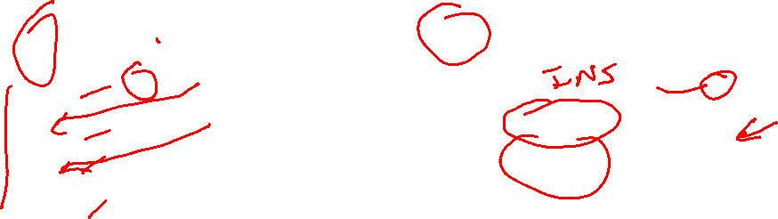
Transaction Log

Slide 22
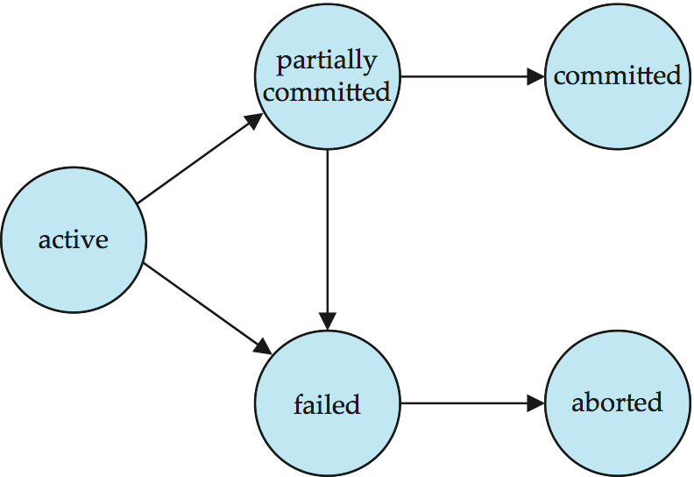
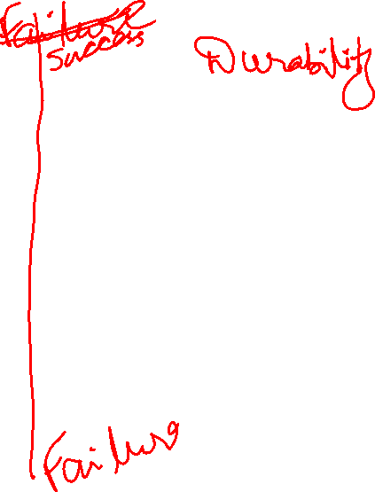
Transaction State Diagram

Slide 23
Transaction State
Active – the initial state; the transaction stays in this state while it is executing
Partially committed – after the final statement has been executed.
Failed -- after the discovery that normal execution can no longer proceed.
Aborted – after the transaction has been rolled back and the database restored to its state prior to the start of the transaction. Two options after it has been aborted:
restart the transaction
can be done only if no internal logical error
kill the transaction
Committed – after successful completion.
Note: External or user facing writes! E.g. Email, ATM, Web booking

Slide 24
Issues to deal with when working with Transactions
Failures of various kinds, such as hardware failures and system crashes
→ Use Database recovery algorithms
Concurrent execution of multiple transactions
→ Use Concurrency control algorithms
Note: DBMS cannot guarantee the correctness of the semantic meaning of the user’s transaction

Slide 25
Concurrent Transaction Executions
Advantages of Concurrent Execution:
Increased throughput:
Increased processor and disk utilization, leading to better transaction throughput
one transaction can be using the CPU while another is reading from or writing to the disk
Reduced average response time:
short transactions need not wait behind long ones.
Concurrency control schemes – mechanisms to achieve isolation
control the interaction among the concurrent transactions in order to prevent them from destroying the consistency of the database
But, what happens to isolation property in this case?
How do we handle this situation?

Slide 26
Schedules
Schedule – a sequence of instructions that specify the chronological order in which instructions of concurrent transactions are executed
a schedule for a set of transactions must consist of all instructions of those transactions
must preserve the order in which the instructions appear in each individual transaction.
Commit - A transaction that successfully completes its execution will have a commit instruction as the last statement
by default, a transaction is assumed to execute commit instruction as its last step
Abort - A transaction that fails to successfully complete its execution will have an abort instruction as the last statement

Slide 27
Example 1
Assume the following two transactions are running concurrently in the system:
T₁ :
transfer $50 from A to B.
T₂ :
transfer 10% of the balance from A to B.
Assume:
Starting balance of A = $1000
Starting balance of B = $2000
Total A + B = $3000 ← Consistency Property

Slide 28
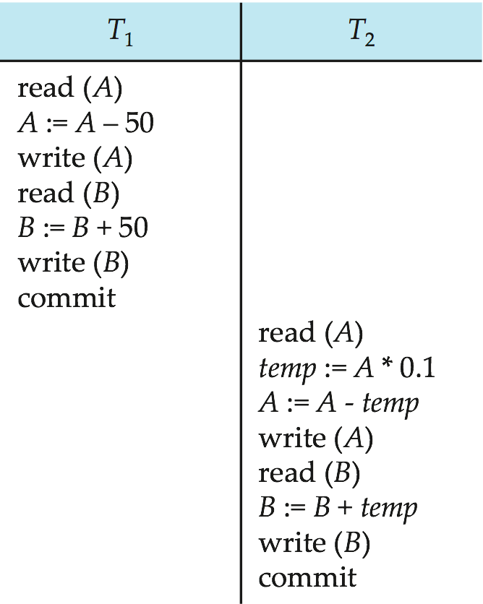

Example 1: Schedule 1
A serial schedule in which T₁ is followed by T₂ :

Slide 29
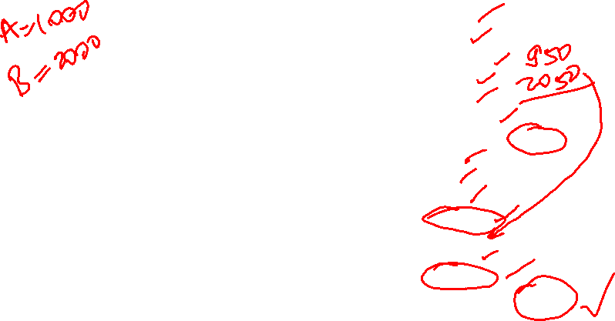
Example 1: Schedule 1
A serial schedule in which T₁ is followed by T₂ :
1000
950
950 (A)
2000
2050
2050 (B)
Total A+B= 3000
950
95
855
855 (A)
2050
2145
2145 (B)
Total A+B= 3000

Slide 30
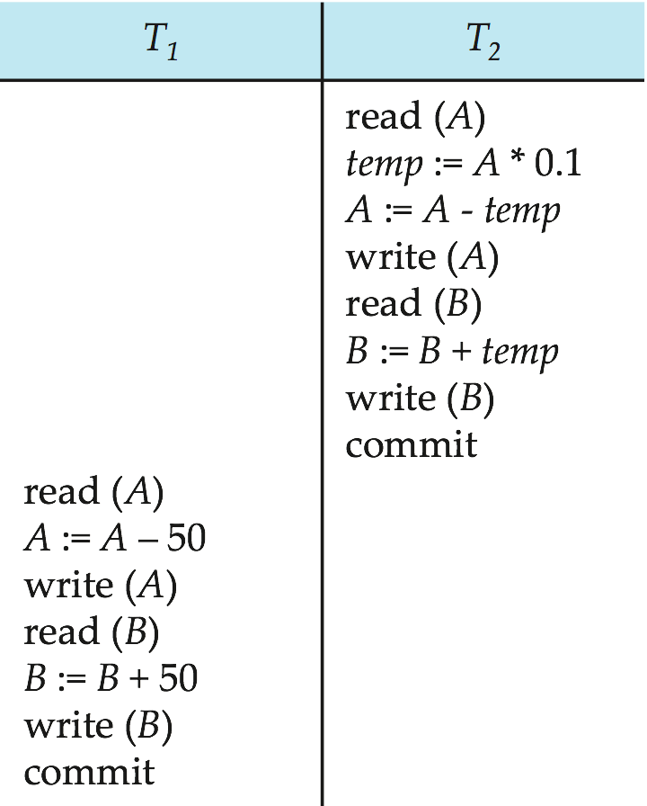
Example 1: Schedule 2
A serial schedule where T₂ is followed by T₁
What is the total at the end
of this transaction?

Slide 31

Example 1: Schedule 2
A serial schedule where T₂ is followed by T₁
1000
100
900
900(A)
2000
2100
2100(B)
900
850
850(A)
2100
2150
2150(B)
Total A+ B = 850 + 2150 = 3000

Slide 32
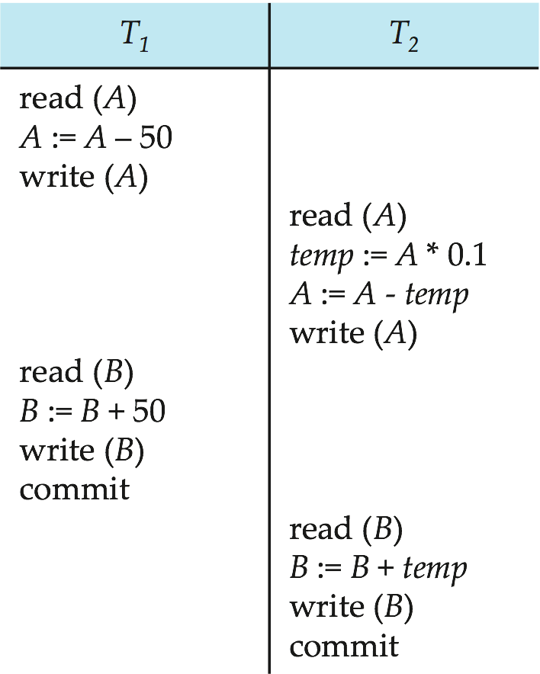
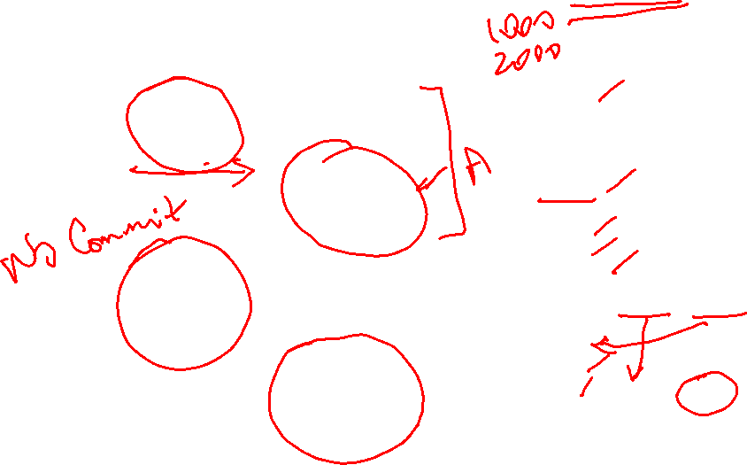
Example 1: Schedule 3
Let T₁ and T₂ be the transactions defined previously. The following schedule is not a serial schedule, but it is equivalent to Schedule 1. How?
1000
950
950(A)
950
95
855 (A)
2000
2050
2050 (B)
Commit (A=855, B=2050)
2050
2145
2145 (A=855, B=2145)
Total A+ B = 855 + 2145 = 3000
In Schedules 1, 2 and 3, the sum A + B is preserved.

Slide 33
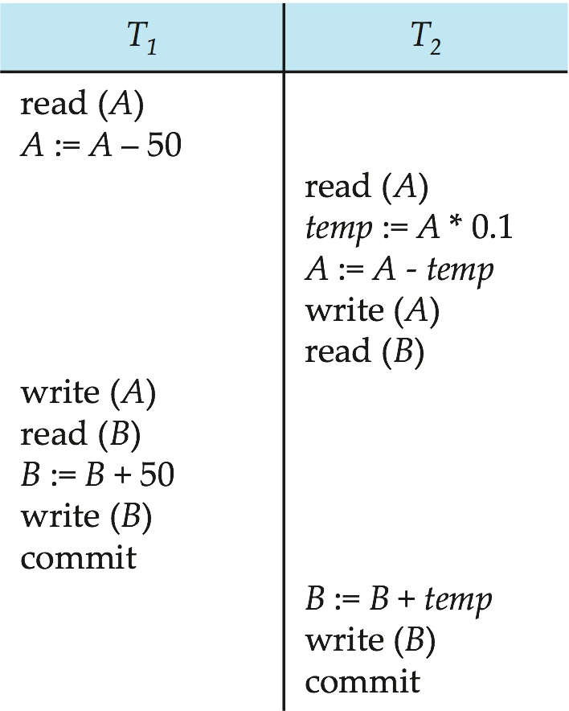

Example 1: Schedule 4
The following concurrent schedule does not preserve the value of (A + B ). Assign values and see why?

Slide 34

Example 1: Schedule 4
The following concurrent schedule does not preserve the value of (A + B ). Assign values and see why?
1000
950
A=950
2000
2050
2050
A=950
B=2050
1000 (No Write of A in T1)
100
900
A=900
B=2000
2150
B=2150
A + B = 950 + 2150 = 3100

Slide 35
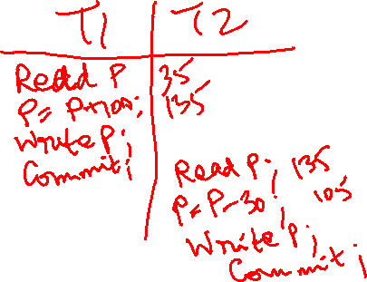
Class Exercise
Create a Schedule T1 followed by T2, for the following operations on the PRODUCT table:
Assume Product P = 35
T1: Add 100 units to each product ➔
P = P +100
T2: Sell 30 units from each product ➔
P = P - 30
Add Read, Write, Commit as needed. Check Total.
T1 | T2
Read P
P = 35 + 100
Write P (135)
commit;
 | Read P (135)
 | P = 135 – 30
 | Write P (105)
 | commit;

Slide 36
Simplified view of transactions
Simplified schedules consist of only read and write instructions.
READ:
Does not alter the database state
SELECT CUS_CODE, CUS_BALANCE
FROM CUSTOMER
WHERE CUS_CODE = 1001
WRITE:
changes the database state
UPDATE PRODUCT
SET PROD_QOH = PROD_QOH +10
WHERE PROD_CODE = ’89-WRE-Q’
We assume that transactions may perform arbitrary computations on data in local buffers in between reads and writes.

Slide 37
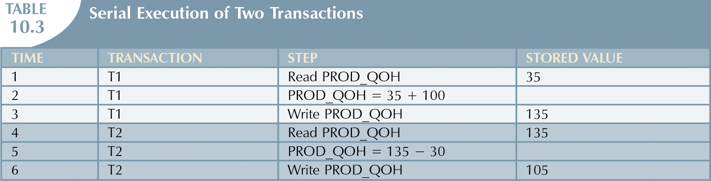

Notation for transactions
T1: R(Q) W(Q) C
T2: R(Q) W(Q)C

Slide 38
Problems of Concurrent Transactions
When two transactions are working on the database concurrently, the following problems might arise:
Lost Update ← ← ←
Dirty Read
Unrepeatable read

Slide 39
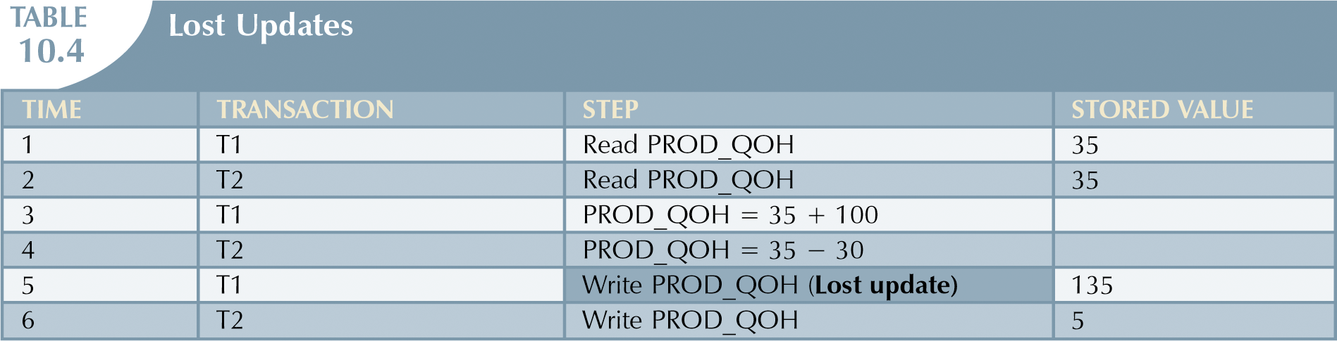
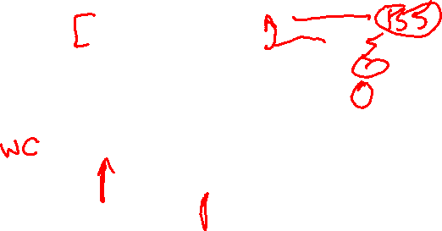
Lost Update Problem
T1: R(Q) W(Q) C
T2: R(Q) W(Q)C
Lost Update of T1 (135)

Slide 40
Lost Updates Problem (continued)
When two transactions are updating the same data element and one of the updates is lost:
Overwritten by the other transaction

Slide 41
Example 2
T1: BEGIN A=A+100, B=B-100 END
T2: BEGIN A=1.1*A, B=1.1*B END
T1 is transferring $100 from B’s account to A’s account.
T2 is crediting both accounts with a 10% interest payment.
There is no guarantee that T1 will execute before T2 or vice-versa, if both are submitted together.
However, the net effect must be equivalent to these two transactions running serially in some order.

Slide 42

Example 2 (continued)
Consider the following schedules:
Schedule 1:
T1: R(A), A=A+100 ,W(A) R(B),B=B-100,W(B)
T2: R(A),A=1.1*A, W(A) R(B),B=1.1*B,W(B)
Schedule 2:
T1: R(A),A=A+100,W(A),R(B) B=B-100,W(B)
T2: R(A),A=1.1*A,W(A), R(B), B=1.1*B,W(B)
Schedule 2 causes the lost update problem because the value of B that was written by T2 is overwritten by T1

Slide 43
Problems of Concurrent Transactions
When two transactions are working on the database concurrently, the following problems might arise:
Lost Update
Dirty Read ← ← ←
Unrepeatable read

Slide 44
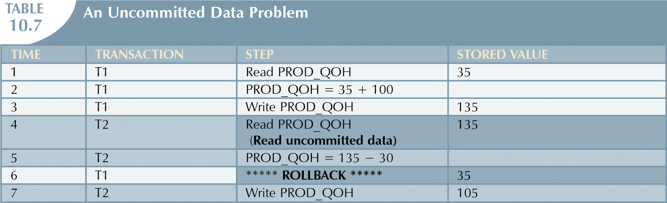
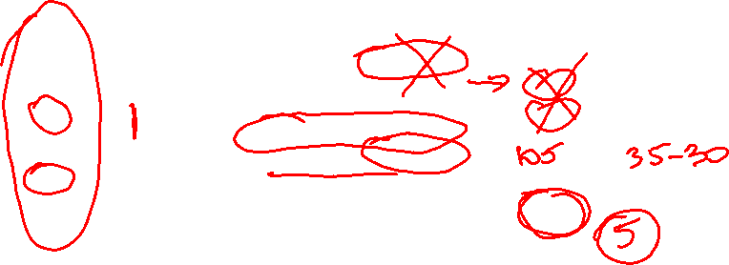
Problem 2: Dirty Read Reading Uncommitted Data
T1: R(Q) W(Q) Abort
T2: R(Q) W(Q) C
T2 Read Uncommitted Data (Dirty Read)

Slide 45
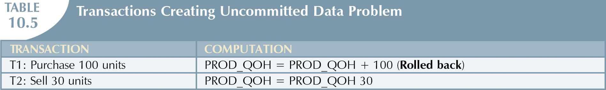
Dirty Read: Reading Uncommitted Data
When T1 and T2 are executed concurrently and T1 is rolled back after T2 has already accessed the uncommitted data

Slide 46
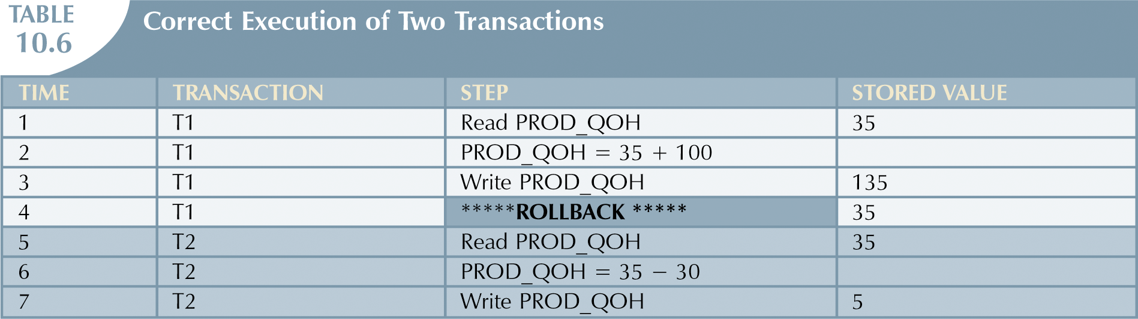

Correct sequence
T1: R(Q) W(Q) Abort
T2: R(Q) W(Q)C

Slide 47

Problem 2: Reading Uncommitted Data
Transaction 1 | Transaction 2
/* Query 1 */ SELECT age FROM users WHERE id = 1; /* will read 20 */
 | /* Query 2 */ UPDATE users SET age = 21 WHERE id = 1; /* No commit here */
/* Query 1 */ SELECT age FROM users WHERE id = 1; /* will read 21 */
 | ROLLBACK; /* lock-based DIRTY READ */
In this case no row exists that has an id of 1 and an age of 21. T2 Read Uncommitted Data (Dirty Read)

Slide 48
Problems of Concurrent Transactions
When two transactions are working on the database concurrently, the following problems might arise:
Lost Update
Dirty Read
Unrepeatable read ← ← ←

Slide 49

Problem 3: Unrepeatable Reads
What is the problem in the following schedule?
T1: R(A) R(A), W(A), C
T2: R(A), W(A), C
In this example, T1 has read the original value of A, and is waiting for T2 to finish.
T2 also reads the original value of A, overwrites A, and commits.
However, when T1 reads to A, it discovers two different versions of A,
and T1 would be forced to abort, because T1 would not know what to do.

Slide 50

Example 4
What is the problem in the following schedule?
T1: R(A), W(A) R(B), W(B), Abort
T2: R(A), W(A), C
What is a real life business scenario where
this can happen?
Real-world example
Alice and Bob are using a website to book tickets for a specific show.
Only one ticket is left for the specific show. Alice signs on first to see that only
one ticket is left, and finds it expensive. Alice takes time to decide. Bob signs on
and also finds one ticket left, and orders it instantly. Bob purchases and logs off.
Alice decides to buy a ticket, to find there are no tickets.
This is a typical read-write conflict situation

Slide 51
Concurrency Control

Slide 52
Reading and Assignment
No. | Date | Topics and Required Reading | Assignments
 |  |  |  | start of class day

